Slide 1
Accessing the Curriculum for Diverse Learners

Slide 2

Activity

Slide 3
Course Description
Students will explore the structure and content of curriculum in BC schools. They will examine universal design and embedded learning opportunities. Students will examine principles, approaches and strategies of applied behaviour analysis and its application to academic learning. Students will expand their repertoire of instructional strategies, particularly as they relate to literacy and numeracy development.

Slide 4

Student Assessment
Embedded Opportunities for Learning Plan – 20%
Task Analysis Plan – 30%
Adapting for Literacy or Numeracy Development – 25%
Accessing the Curriculum Paper – 25%

Slide 5

Activity
Complete matching of words to definitions
Pass to a colleague
Have colleague mark
How did you do?

Slide 6

Keys to Effective Inclusive Teaching
Personal best learning
Authentic
Multi-level
Instruction
Challenging teaching for all
Support - Partnering
Support learning
Community
Democracy - Including All
Meet emotional needs
Space for All
Inclusive Learning Environments

Slide 7

The Goal
There is little evidence that exposure to general education setting alone will result in gains to social, language, development or academic skills of children with disabilities. Active participation is key to learning.

Slide 8


Meaningful Participation
Looks like...
Doesn’t look like...

Slide 9
Instructional Decisions: Participation Options
Same thing, same way
Same thing, different way
Same activity (or component), different goals
Same materials, different activity
Different activity

Slide 10
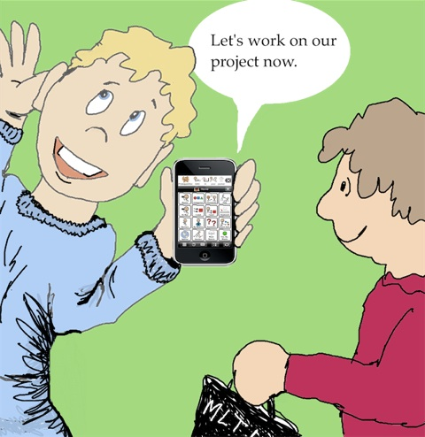
Active Engagement
Engaged behaviour is the single best predictor of academic gains for students with disabilities
The amount of time students with cognitive disabilities are actively engaged in activities has been cited as one of the best predictors of outcomes for these students

Slide 11
Active Engagement
Compared to peers without disabilities, children with disabilities spend
More time passively non-engaged
Less time interactively engaged with adults
Less time attentionally engaged with peers
Less time in mastery level engagement with materials (McWilliam and Bailey)
The problem with all this is
Engagement is a precursor to learning

Slide 12

How can you tell when a student is actively engaged?

Slide 13
Attributes of engagement
Persistence
Sustained involvement
Involvement generally maintained
Intermittent / irregular involvement
Fleeting awareness with little or not involvement
Non engagement

Slide 14
How active?
Active learner involvement needs to occur before, during and after participation if any kind of learning experience is to have optimal effects and benefits.

Slide 15

READ:
IEP – BC Special Education 2009
A Parent’s Guide to Universal Design for Learning

